Slide 1


Group X
Real-Time Weather Dashboard
Final Project Presentation
PRESENTED BY
Group Members : Çınar Acar
Kaleab Tesfaye
Mohammed Elshami

Slide 2
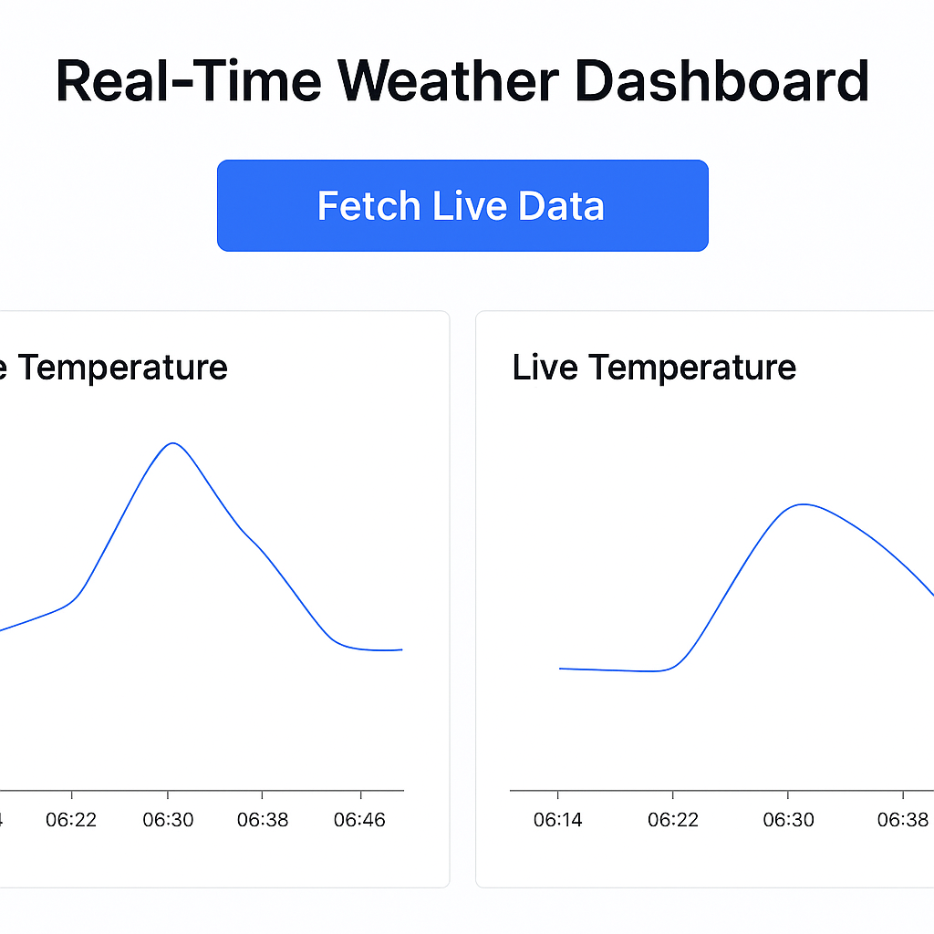
Project Goal
The Real-Time Weather Dashboard aims to efficiently fetch, store, and visualize weather data, making it accessible through a user-friendly web interface for better decision-making.
Build an end-to-end prototype that shows live weather data.
Demonstrate pipeline:
fetch → parse → store → query → visualize.
Provide a simple web UI to trigger live fetch and view charts

Slide 3
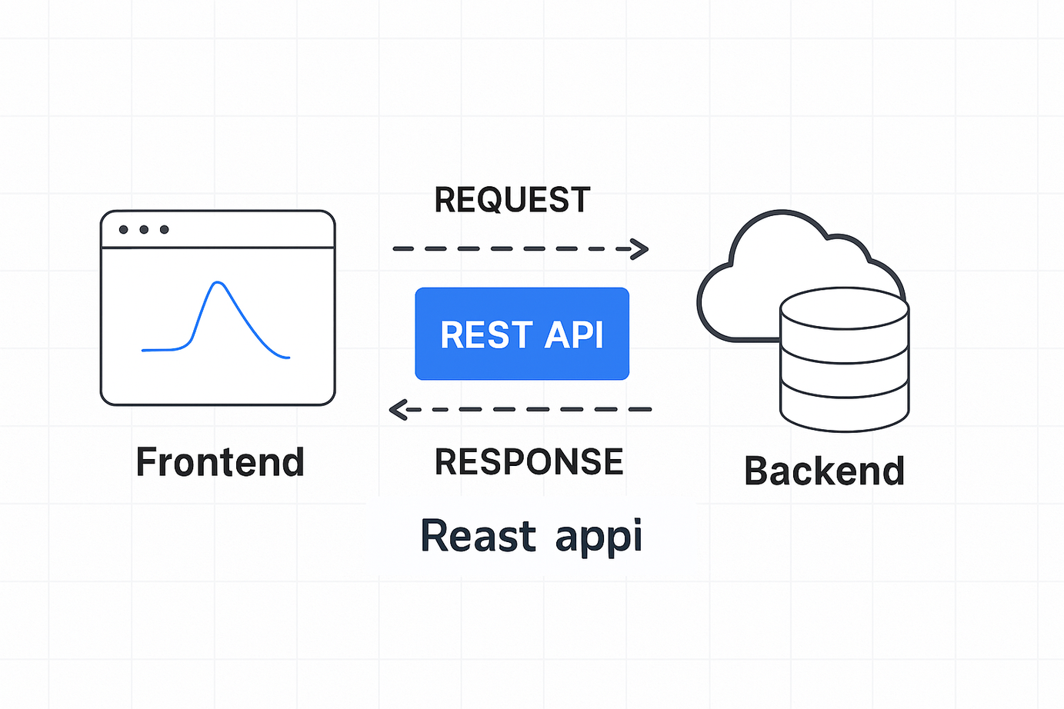
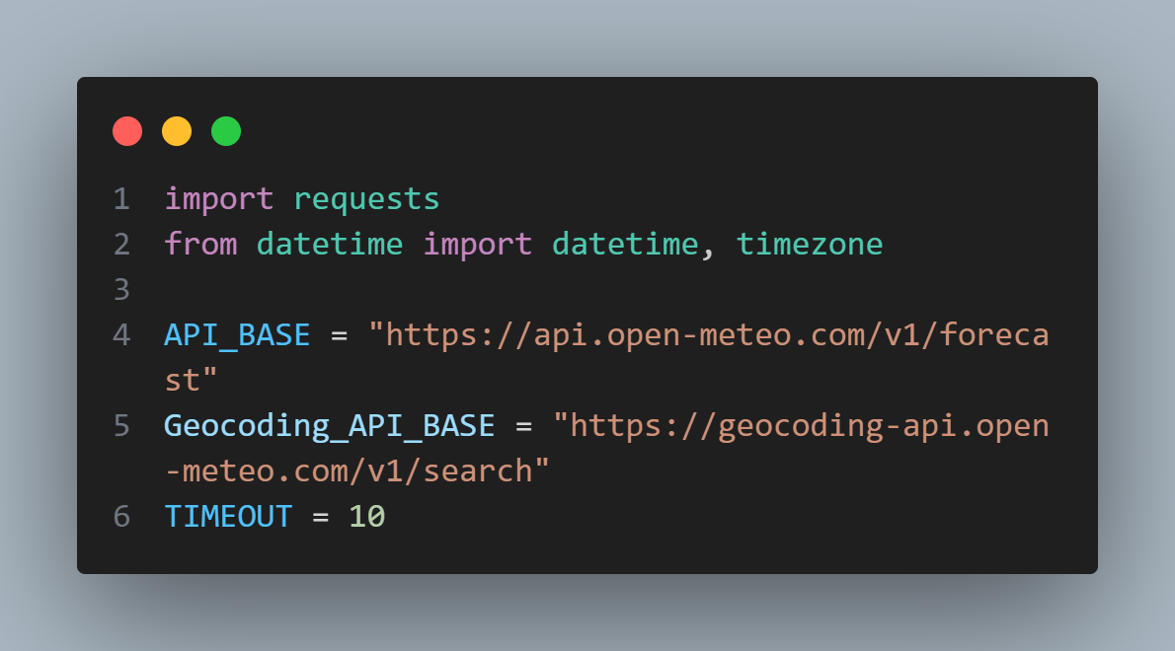
What is an API
Our API: Open-Meteo
It allows different software systems to communicate by sending and receiving data.
An API endpoint is just a URL that gives you data when you request it.
Free, no API key required
Designed for weather forecasting and geolocation
Fast and lightweight — ideal for student projects
A REST API acts like a bridge between our Python program and live data on the internet.
This connection makes it possible to fetch, parse, and display real-time weather information directly in our dashboard.

Slide 4
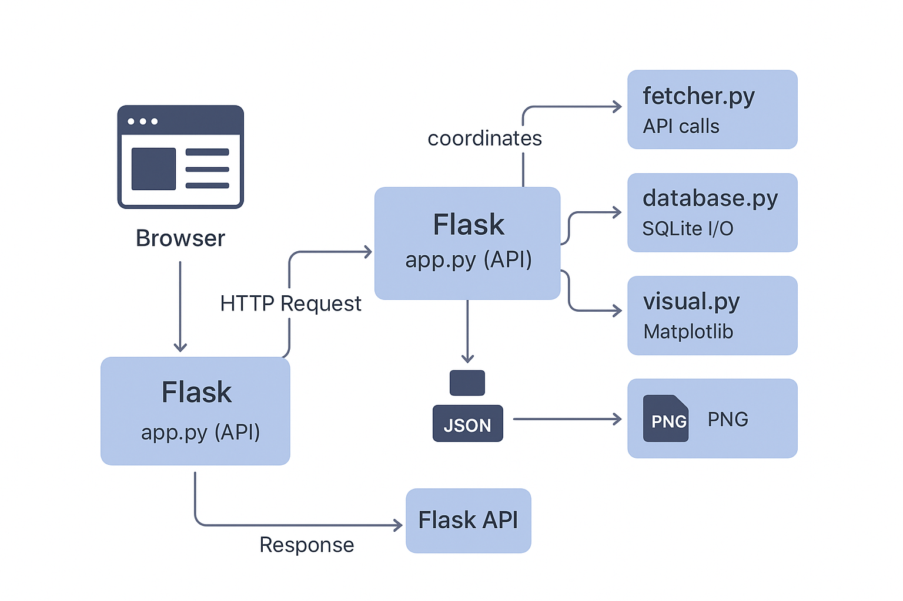
System Architecture
This section outlines the request flow from the user's browser through the Flask web framework, interacting with various Python modules to deliver a seamless, real-time weather experience.

Slide 5
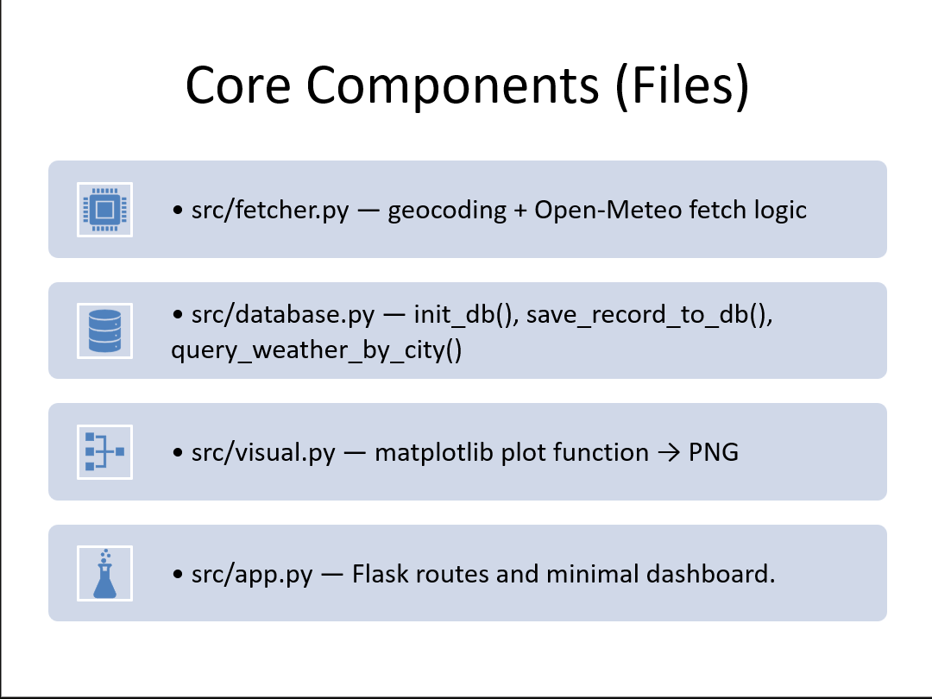
Main Components
This section outlines the key Python files that power our Real-Time Weather Dashboard, detailing their specific roles, such as fetching data, managing the database, and visualizing results.

Slide 6
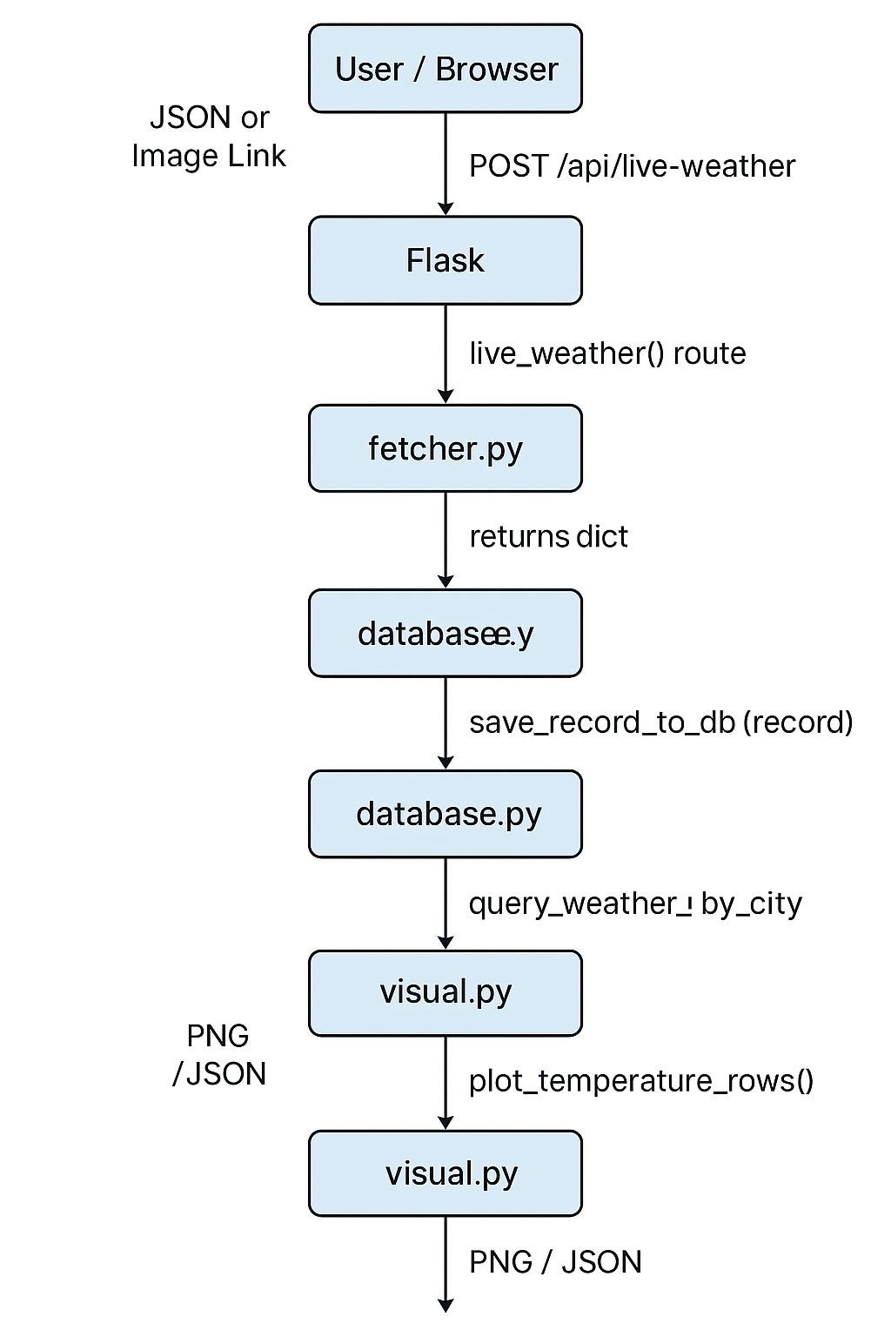
Data Flow
This section illustrates the comprehensive data flow from user city selection through to data fetching and storage, culminating in chart generation and the final Flask response.

Slide 7

Code Features
Our weather dashboard efficiently handles API requests, ensuring structured data storage with timestamps, generating insightful charts, and providing a user-friendly web interface for seamless interaction.
Live weather: fetch current temperature, windspeed, humidity for a selected city.
5-day forecast: retrieve and display the 5-day forecast summary.
Historical chart: show temperature time-series as a PNG chart (Matplotlib) or interactive chart.
Dynamic UI: page background (animated GIF) changes based on the current weather type (sun, rain, snow, etc.).
Simple web UI: Bootstrap dashboard with city selector, “Get Live Weather” button, and recent rows table.

Slide 8
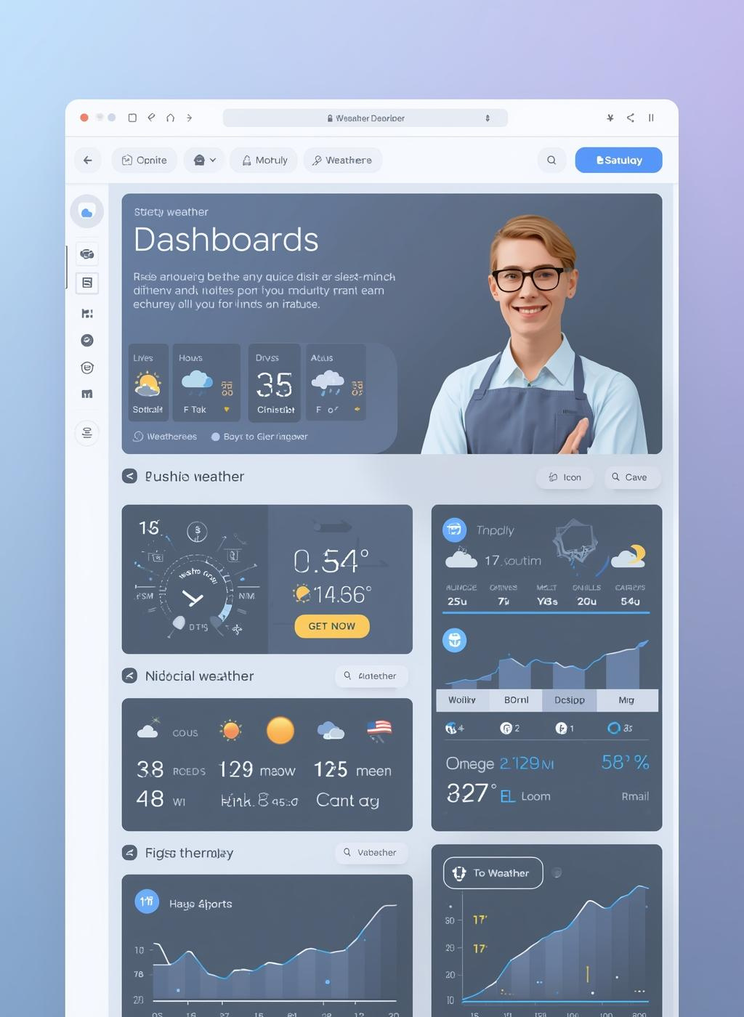
Flask Endpoints
This section outlines the main Flask endpoints of our Real-Time Weather Dashboard, detailing how users can access historical weather data, fetch live updates, and view static charts.
( / ): renders the dashboard (HTML)
(GET /api/weather/<city> ) — returns historical temperature & timestamps in JSON
(POST /api/live-weather )— fetches live weather, saves to DB, sends JSON back
(/static/*) — serves PNG charts + GIF backgrounds for UI

Slide 9
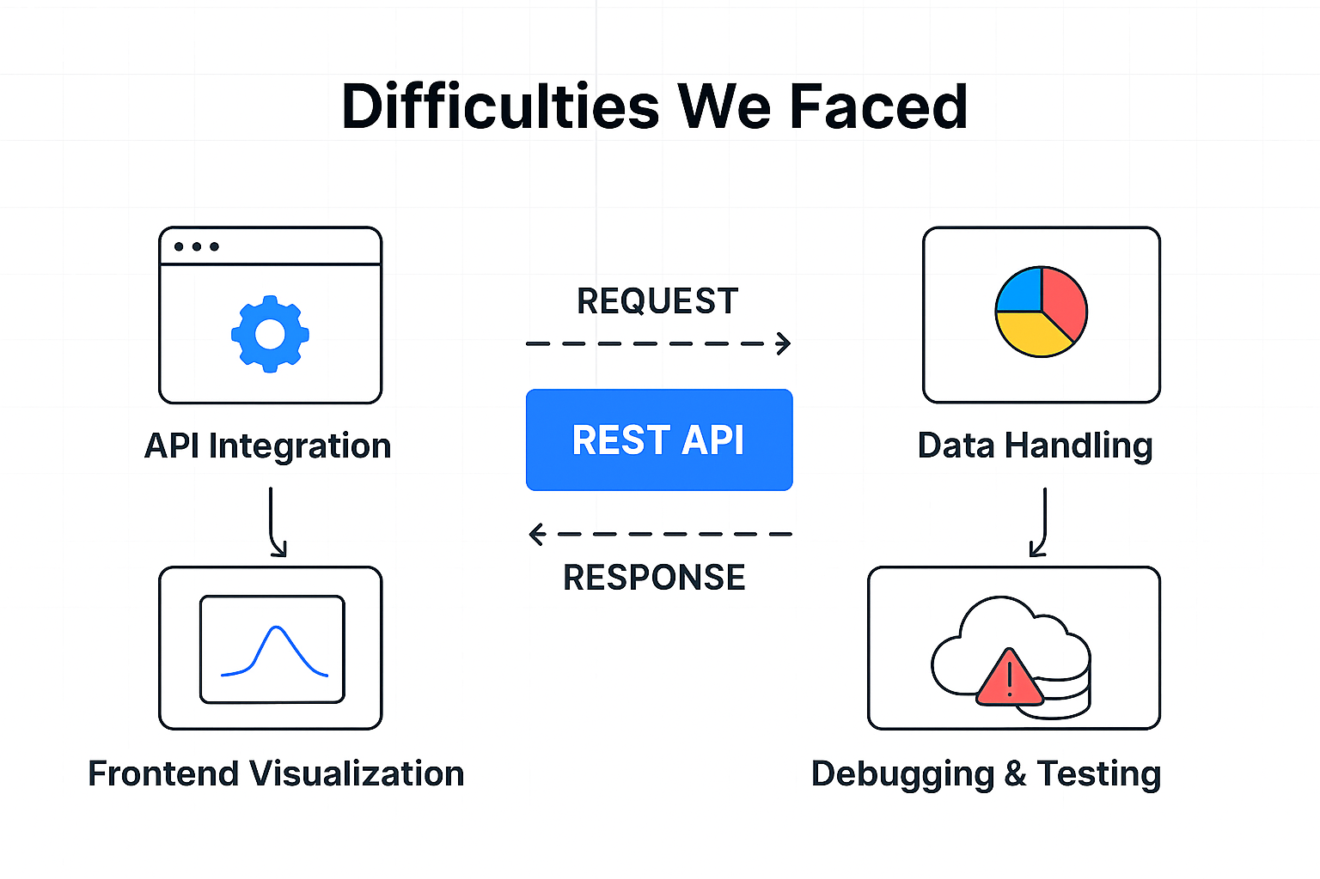
⚠️ Difficulties We Faced
Data Handling
Converting city names into coordinates via Geocoding before fetching forecasts.
Managing time zones and date formats consistently across different cities.
Git hub Collabration:
Merge Conflicts
When two people edited the same file, GitHub flagged conflicts that had to be resolved manually.
Branch Management
Sometimes teammates forgot to create a new branch and pushed directly to main, causing instability.
Sync/Update Local Repo
Team members pull the latest changes to stay up-to-date.

Slide 10

Q&A
Thank you for listening. Please feel free to ask any questions.

